Slide 1


Computer Science in Modern Biology Data Visualization in .
Instructor:
Addison Zeisler
TAs:
Keaka Farleigh
Karly Cazzato
Course developed by Rachel Pilla

Slide 2
Workshop Schedule
Day 1 (Wednesday):
Structure and design of graphs
Creating graphs in base R
Overview of ggplot2
Day 2 (Thursday):
Introduction to ggplot2
Building graphs and customizing in ggplot2
Additional graphing resources
Q&A and practice

Slide 3
Workshop Logistics
Zoom
Feel free to unmute yourself to ask questions at any point
Chat
Post any questions or comments here
The TAs will be checking the chat to help answer questions
Break-Out Rooms
If you are really stuck, you can move to a break-out room with a TA to share your screen and get you up to speed
Break time is a great opportunity for this if needed!

Slide 4
Packages in R
Packages are bundles of tools and functions that others have developed to be used in R
They are often grouped to specific types of functions, analyses, or datasets
rLakeAnalyzer, for example, has lots of functions developed by limnologists to help you analyze common types of data collected from lakes

Slide 5
Packages in R
Currently, there are over 16,000 packages!
We are going to install 2 packages to use today:
ggplot2
ggpubr

Slide 6
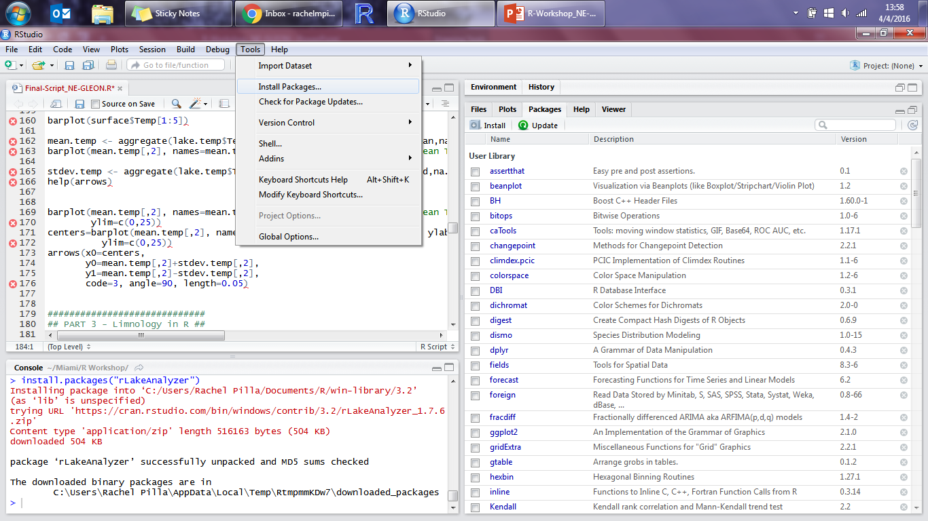
Installing a Package
Tools → Install Packages…

Slide 7
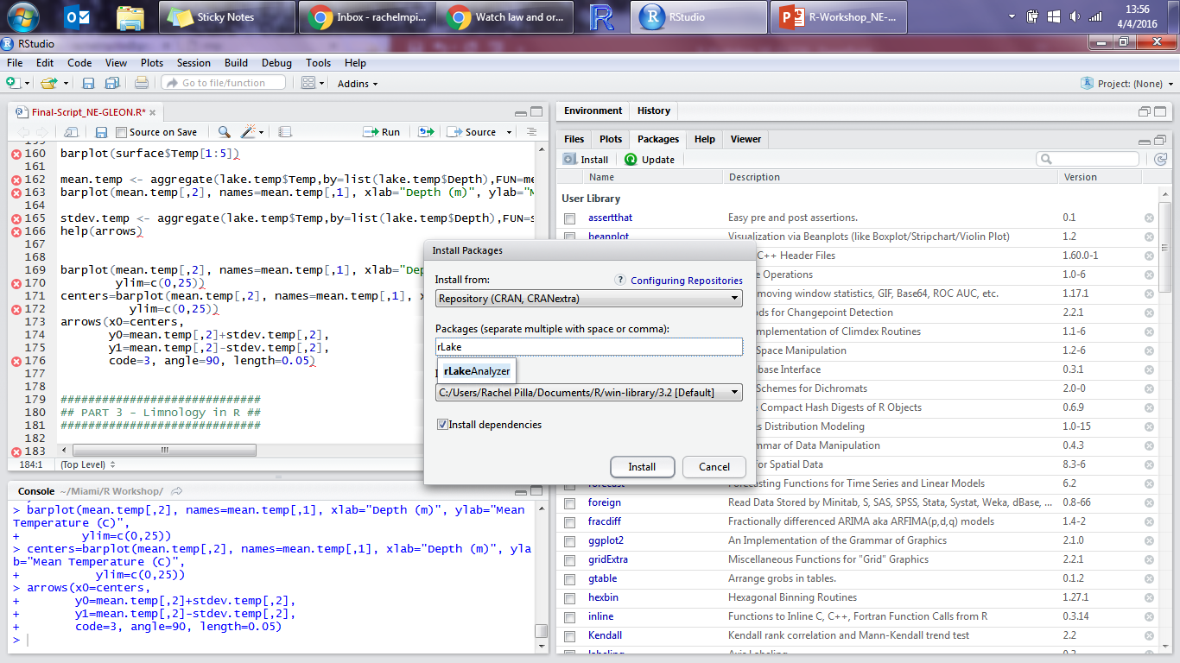
Installing a Package
Type the packages you want to install: ggplot2, ggpubr

Slide 8
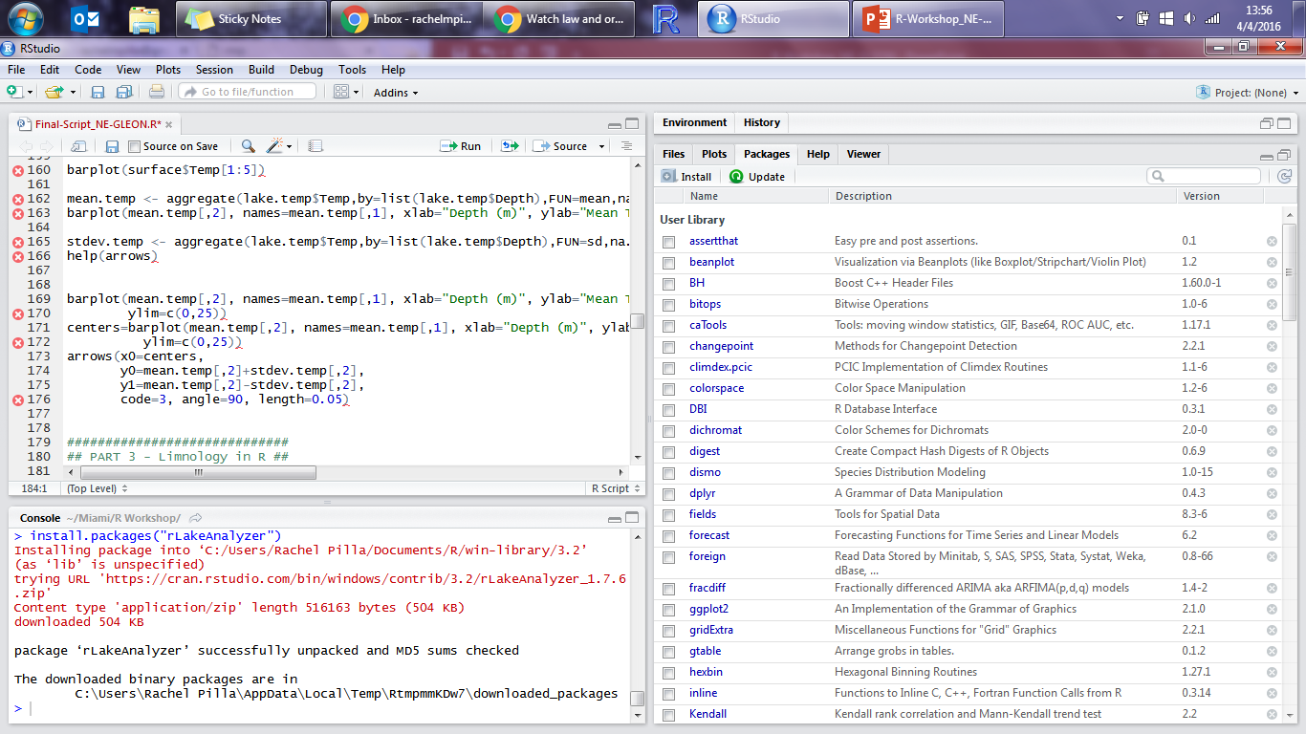
Installing a Package
Console will tell you when they have been installed

Slide 9
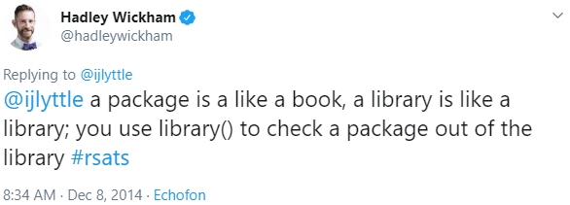
Installing a Package
Packages only need to be installed ONCE
But, each time you re-open R, you need to load the package(s) you want to use so R can make all the functions available:
library(package name)

Slide 10
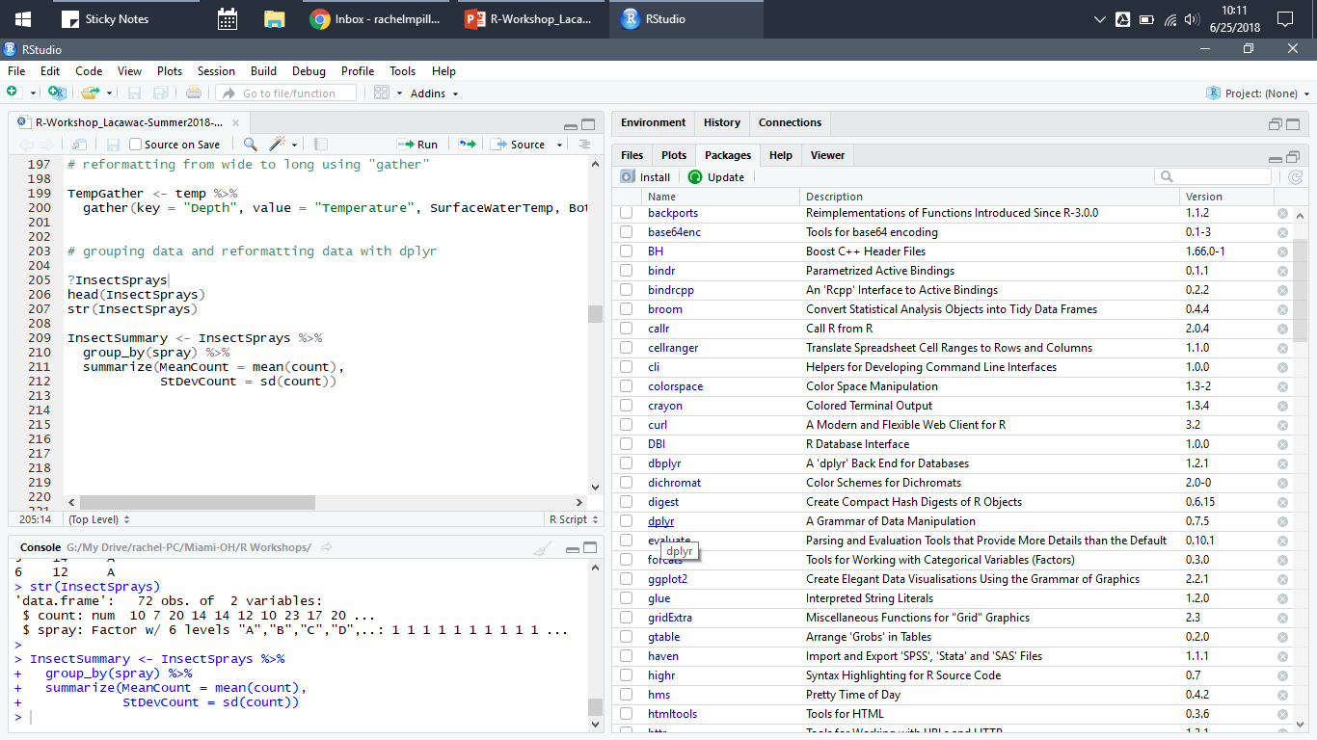
Package Information
Under the “Packages” tab, click on dplyr

Slide 11
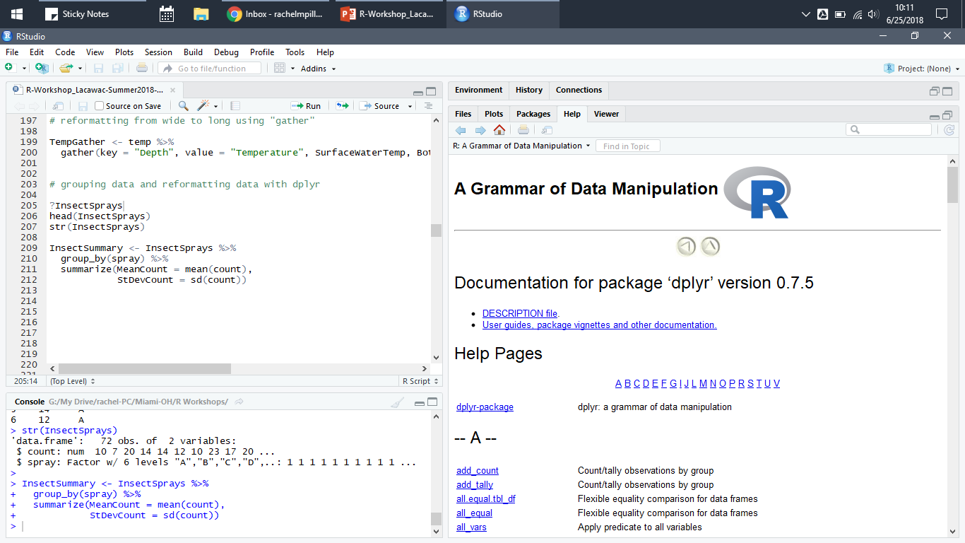
Package Information
This will list all the available functions
Clicking on a function takes you to the help file

Slide 12
Structure & Design of Graphs

Slide 13
Components of a Graph
Axes
Horizontal x-axis and vertical y-axis
Labels
What are your axes measuring?
Title and/or caption
Description and information about the graph
Legend (sometimes)
If multiple lines, colors, shapes, etc., what does each represent?
DATA
The actual information!

Slide 14
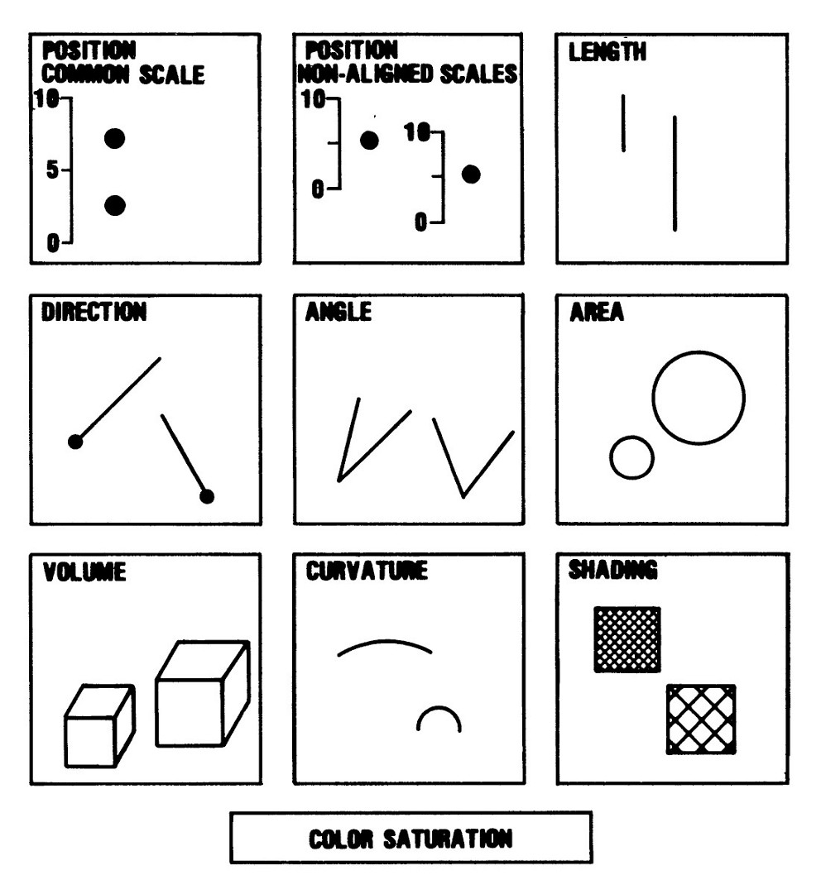
Understanding a Graph
Easy to perceive and understand
May require more work to understand
Can be very valuable when used appropriately in graphs
Cleveland & McGill, 1984 (Journal of the American Statistical Association)

Slide 15
Understanding a Graph
Cleveland & McGill, 1984 (Journal of the American Statistical Association)

Slide 16
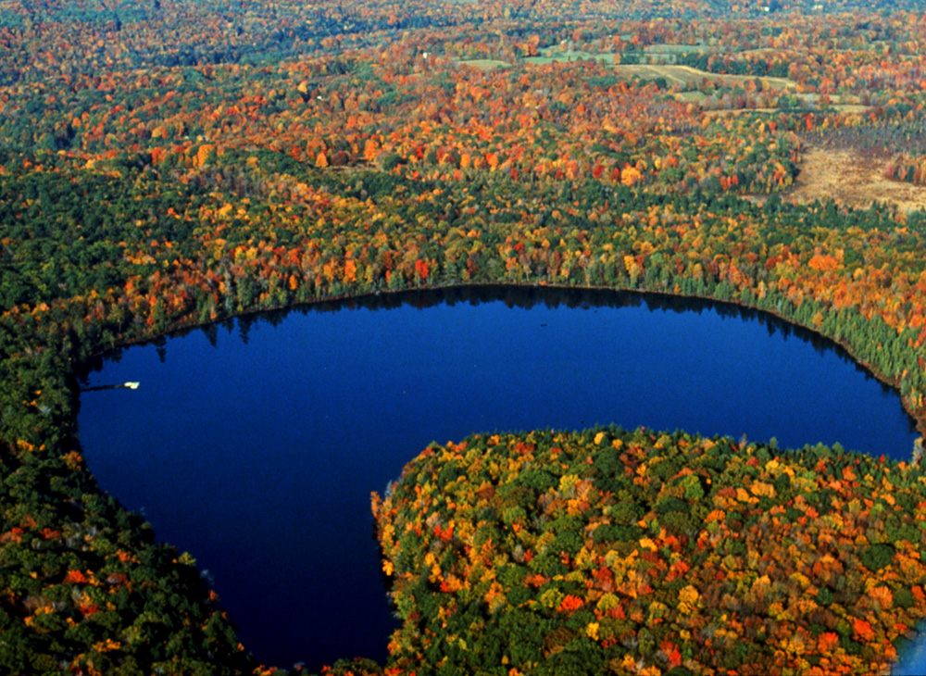
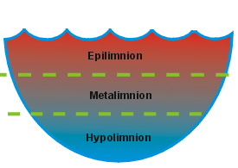
Common Types of Graphs
Lake Lacawac (Pennsylvania)
Water temperature distribution

Slide 17
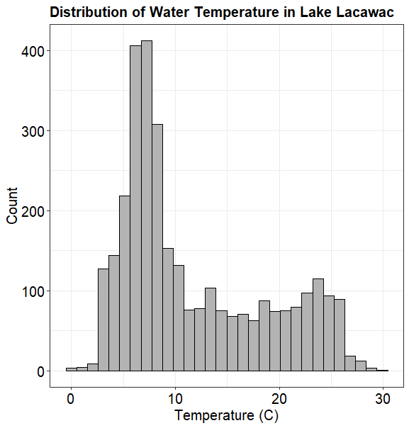
Common Types of Graphs
One variable:
Temperature of Lake Lacawac
Histogram
Density plot

Slide 18
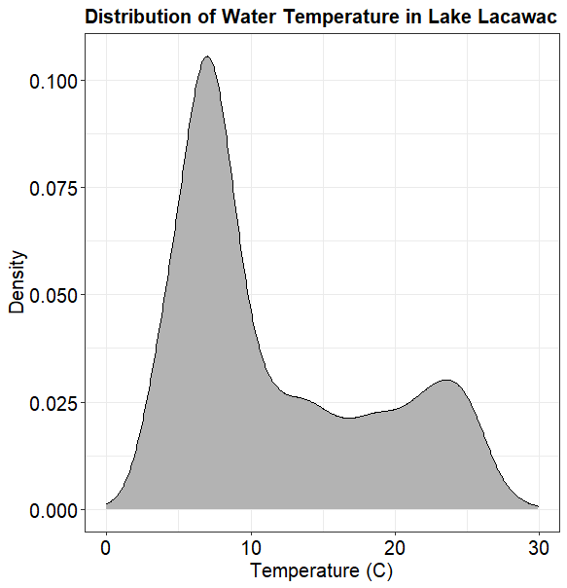
Common Types of Graphs
One variable:
Temperature of Lake Lacawac
Histogram
Density plot

Slide 19
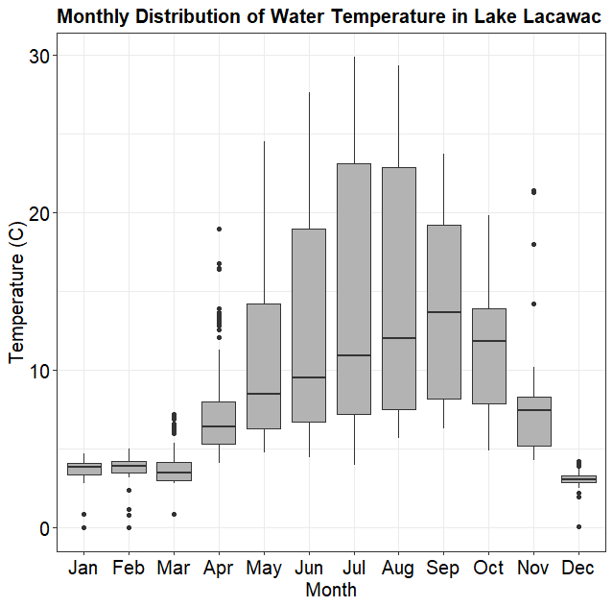
Common Types of Graphs
Two variables:
Temperature of Lake Lacawac for each month of the year
Box plot
Bar plot
X-Y scatterplot
Line plot

Slide 20
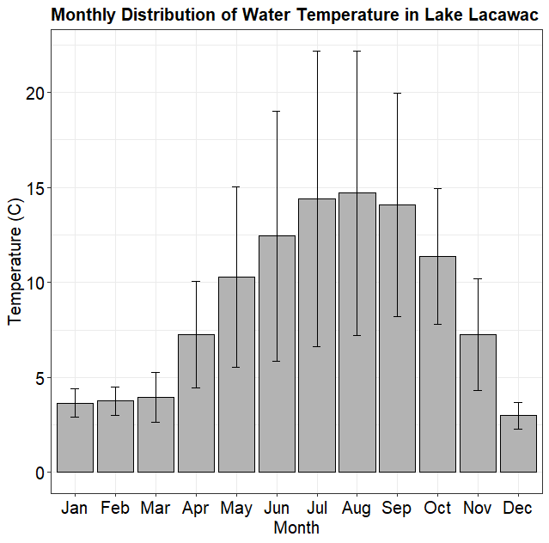
Common Types of Graphs
Two variables:
Temperature of Lake Lacawac for each month of the year
Box plot
Bar plot
X-Y scatterplot
Line plot

Slide 21
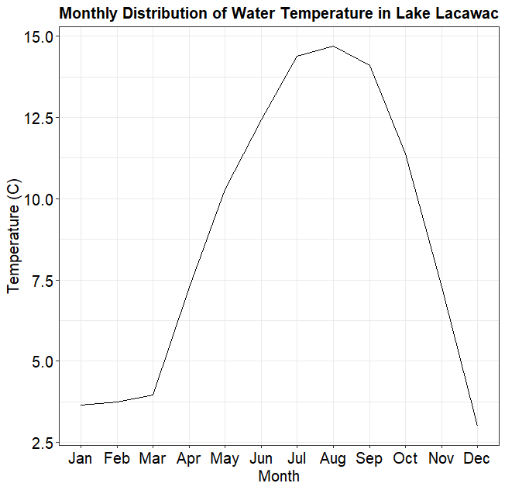
Common Types of Graphs
Two variables:
Temperature of Lake Lacawac for each month of the year
Box plot
Bar plot
Line plot

Slide 22
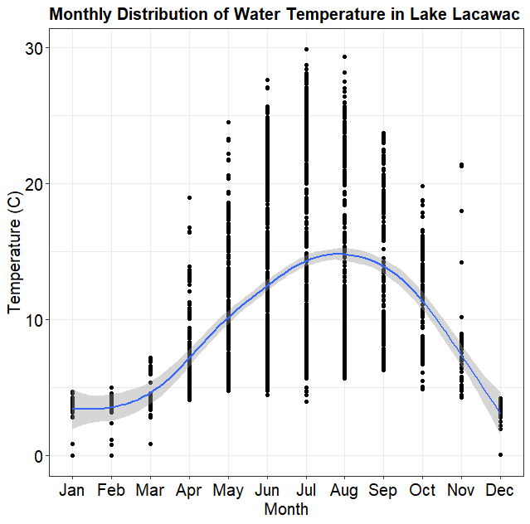
Common Types of Graphs
Two variables:
Temperature of Lake Lacawac for each month of the year
Box plot
Bar plot
Line plot
X-Y scatterplot

Slide 23
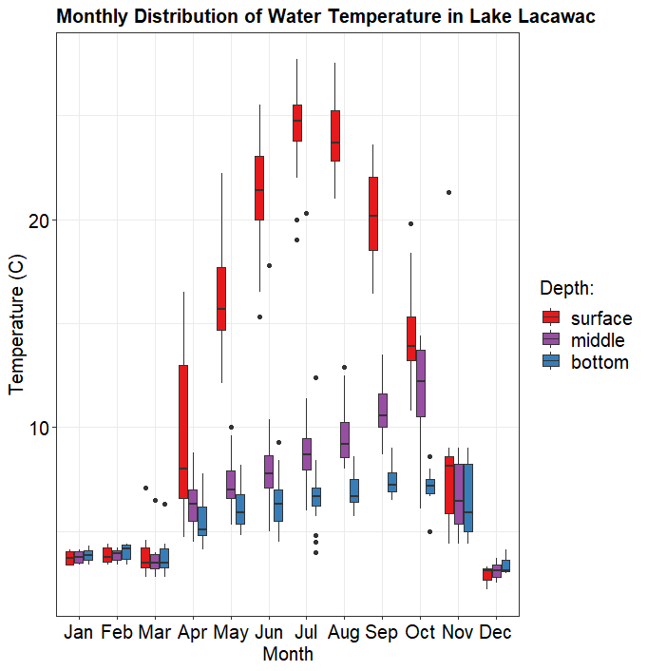
Common Types of Graphs
Three⁺ variables:
Temperature of Lake Lacawac at multiple depths for each month of the year
Box plot
Bar plot
X-Y scatterplot
Line plot
Contour plot

Slide 24
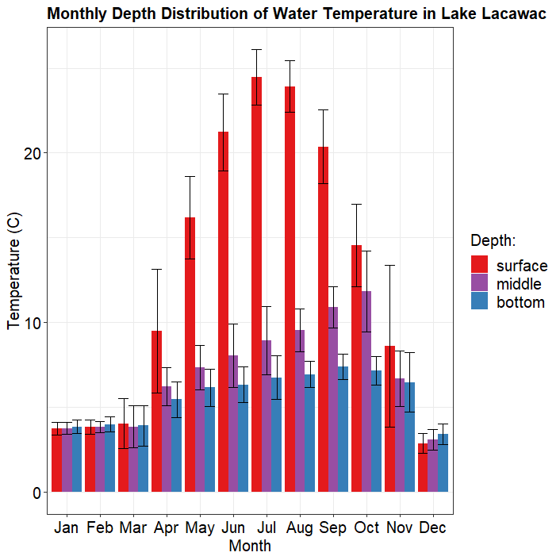
Common Types of Graphs
Three⁺ variables:
Temperature of Lake Lacawac at multiple depths for each month of the year
Box plot
Bar plot
X-Y scatterplot
Line plot
Contour plot

Slide 25
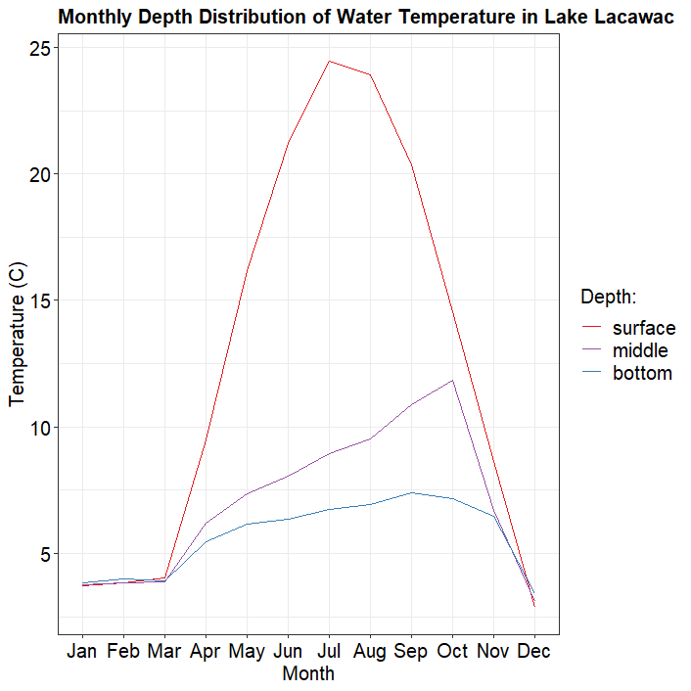
Common Types of Graphs
Three⁺ variables:
Temperature of Lake Lacawac at multiple depths for each month of the year
Box plot
Bar plot
Line plot
X-Y scatterplot
Contour plot

Slide 26
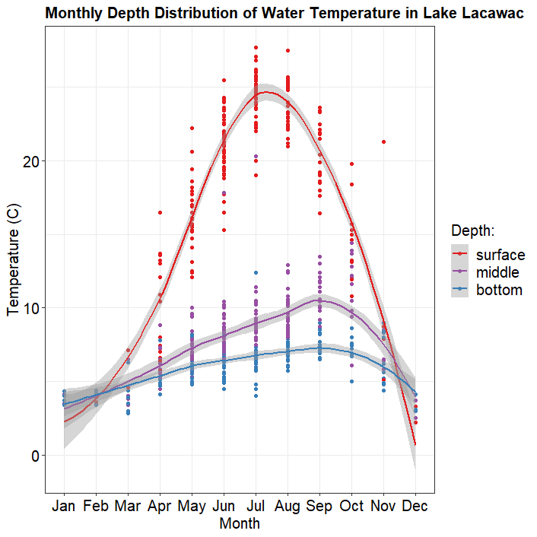
Common Types of Graphs
Three⁺ variables:
Temperature of Lake Lacawac at multiple depths for each month of the year
Box plot
Bar plot
Line plot
X-Y scatterplot
Contour plot

Slide 27
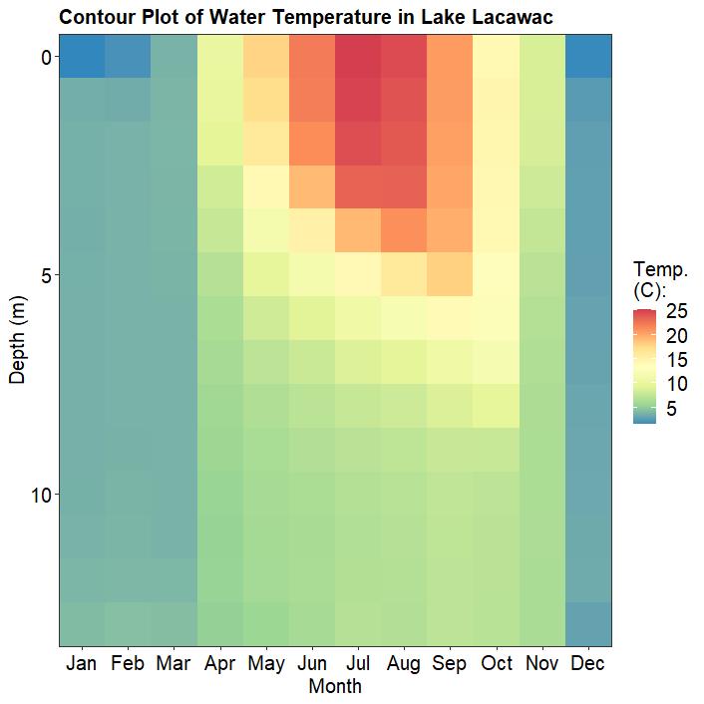
Common Types of Graphs
Three⁺ variables:
Temperature of Lake Lacawac at multiple depths for each month of the year
Box plot
Bar plot
Line plot
X-Y scatterplot
Contour plot

Slide 28
Keys to a Good Graph
Graphs are only as useful as the data they display
Don’t accidentally or purposefully distort or mislead
If the data is simple, keep the graph simple
If the data is complex, make the graph simple to understand

Slide 29
Examples of Graphs
OVERLY COMPLEX GRAPH!
Three axes with 3 different variables
How is solar radiation directly related to stock prices?
from Ross Ihaka, University of Auckland, New Zealand

Slide 30
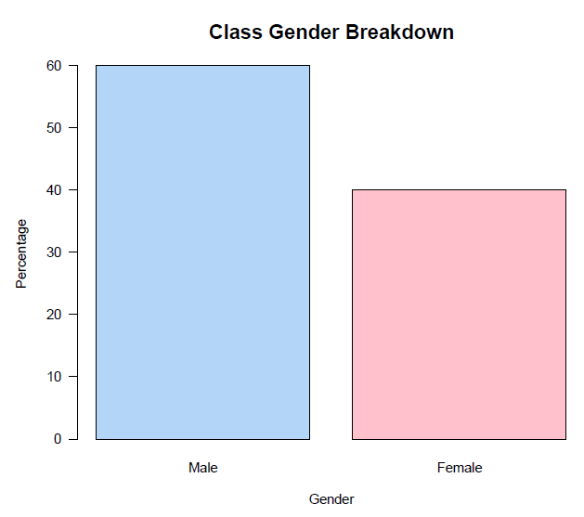
Examples of Graphs
UNNECESSARY GRAPH!
Interpret 3 total components (2 axes and 1 color scheme) for only 2 pieces of data
IMPROVEMENT:
Just report “60% male and 40% female”
from Ross Ihaka, University of Auckland, New Zealand

Slide 31
Examples of Graphs
OVERLY COMPLEX GRAPH!
Extra dimension is unnecessary – beware of 3-D graphs in Excel!
Four colors misleads how many pieces of data are being presented
Unnecessary splitting of y-axis
from Ross Ihaka, University of Auckland, New Zealand

Slide 32
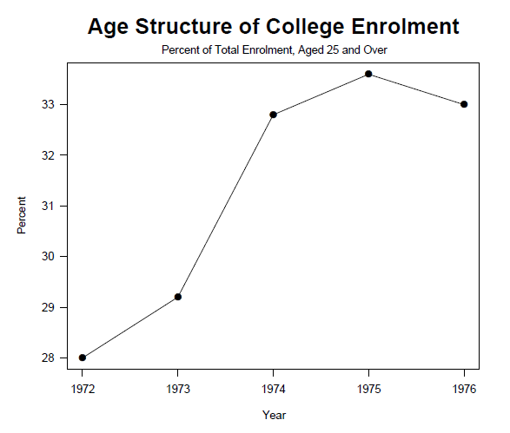
Examples of Graphs
IMPROVEMENTS:
Remove 3-D
Focus on simple presentation of 5 key data points
Clear axes
from Ross Ihaka, University of Auckland, New Zealand

Slide 33
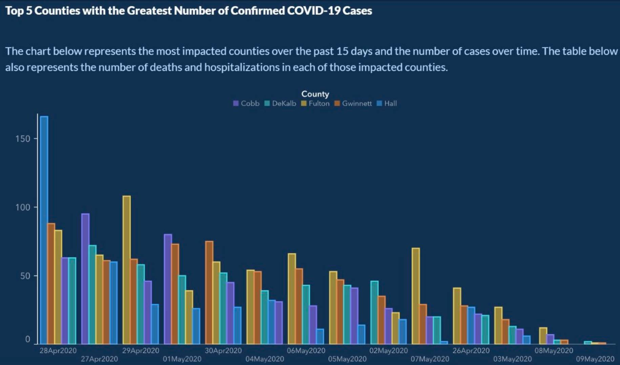
Examples of Graphs
MISLEADING GRAPH!
Dates on x-axis are not in chronological order
No clear y-axis label
Bars/colors are not always in the same order

Slide 34
Examples of Graphs
IMPROVE THIS GRAPH:
Sketch a rough graph of how you would improve this!
Remember the key components of graphs!

Slide 35
Examples of Graphs
data from https://github.com/nytimes/covid-19-data

Slide 36
Live Coding
open RStudio and code along!

Slide 37
Overview of ggplot2

Slide 38
Grammar of Graphics
Originally developed by Leland Wilkinson, adapted for R by Hadley Wickham
Descriptive language to talk about components and visual elements of a graph or plot
Data being plotted
Geometric objects (lines, points, etc.)
Aesthetic appearance
Statistical information and transformations
Position, scales, coordinates
Facets or panels

Slide 39
Grammar of Graphics
Building a plot in ggplot2 is essentially constructing layers or pieces of a plot based on specific aspects of the data
Each new layer is one new piece of code

Slide 40
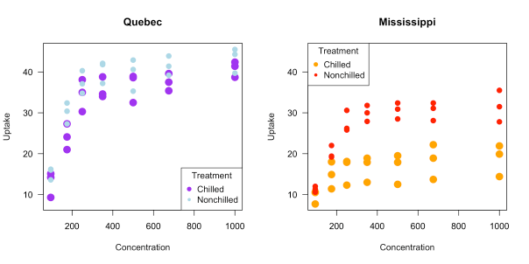
Base R vs. ggplot2
CO₂ uptake in chilled vs. non-chilled treatments in 2 locations:
https://statsinthewild.com/2019/08/22/ggplot2-vs-base-r-graphics-an-example/

Slide 41
Base R vs. ggplot2
Base R code (30 lines):
summary(CO2) str(CO2) head(CO2, 20) CO2.QC <- subset(CO2, Type == "Quebec" & Treatment == "chilled") CO2.QN <- subset(CO2, Type == "Quebec" & Treatment == "nonchilled") CO2.MC <- subset(CO2, Type == "Mississippi" & Treatment == "chilled") CO2.MN <- subset(CO2, Type == "Mississippi" & Treatment == "nonchilled") xrange <- range(CO2$conc) yrange<-range(CO2$uptake) par(mfrow = c(1, 2)) plot(CO2.QC$uptake ~ CO2.QC$conc, pch = 19, lty = 2, lwd = 3, cex = 1.5, las = 1, ylim = yrange, xlim = xrange, col = "purple", xlab = "Concentration", ylab = "Uptake") par(new=T) plot(CO2.QN$uptake ~ CO2.QN$conc, pch = 20, lty = 2, lwd = 3, cex = 1.5, las = 1, ylim = yrange, xlim = xrange, col = "lightblue", main = "Quebec", xlab = "", ylab = "") legend("bottomright", title = "Treatment", c("Chilled", "Nonchilled"), pch = c(19, 20), col = c("purple", "lightblue")) plot(CO2.MC$uptake ~ CO2.MC$conc, pch = 19, lty = 2, lwd = 3, cex = 1.5, las = 1, ylim = yrange, xlim = xrange, col = "orange", xlab = "Concentration", ylab = "Uptake") par(new=T) plot(CO2.MN$uptake ~ CO2.MN$conc, pch = 20, lty = 2, lwd = 3, cex = 1.5, ylim = yrange, las = 1, xlim = xrange, col = "red", main = "Mississippi", xlab = "", ylab = "") legend("topleft", title = "Treatment", c("Chilled", "Nonchilled"), pch = c(19,20), col = c("orange", "red")) par(mfrow = c(1, 1), las = 1)

Slide 42
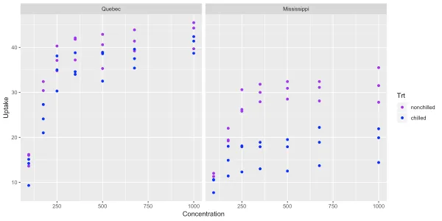
Base R vs. ggplot2
CO₂ uptake in chilled vs. non-chilled treatments in 2 locations:
https://statsinthewild.com/2019/08/22/ggplot2-vs-base-r-graphics-an-example/

Slide 43
Base R vs. ggplot2
ggplot2 code (8 lines):
library(ggplot2)
ggplot(aes(x = conc, y = uptake, color = Treatment), data = CO2) + geom_point() + facet_grid( ~ Type) + xlab("Concentration") + ylab("Uptake") + labs(color = "Trt") + scale_color_manual(values = c("purple","blue"))

Slide 44
Base R vs. ggplot2
Plotting in base R can be very useful for…
Beginners learning R
Exploratory plots (don’t have to be perfect)
Heat or contour maps with missing data
ggplot2 is often much quicker and more intuitive when creating…
Legends
Groupings
Faceting or panels
Easy customizing for presentations or publications

Slide 45
Computer Science in Modern Biology Data Visualization in .
Instructor:
Addison Zeisler
TAs:
Keaka Farleigh
Karly Cazzato
Course developed by Rachel Pilla

Slide 46
Review of Day 1

Slide 47
Workshop Logistics
Zoom
Feel free to unmute yourself to ask questions at any point
Chat
Post any questions or comments here
The TAs will be checking the chat to help answer questions
Break-Out Rooms
If you are really stuck, you can move to a break-out room with a TA to share your screen and get you up to speed
Break time is a great opportunity for this if needed!

Slide 48
Packages
Packages only need to be installed ONCE
But, each time you re-open R (today!), you need to load the packages you want to use so R can make all the functions available:
library(package name)

Slide 49
Components of a Graph
Axes
Horizontal x-axis and vertical y-axis
Labels
What are your axes measuring?
Title and/or caption
Description and information about the graph
Legend (sometimes)
If multiple lines, colors, shapes, etc., what does each represent?
DATA
The actual information!

Slide 50
Understanding a Graph
Easy to perceive and understand
May require more work to understand
Can be very valuable when used appropriately in graphs
Cleveland & McGill, 1984 (Journal of the American Statistical Association)

Slide 51
Remember: Keys to a Good Graph
Graphs are only as useful as the data they display
Don’t accidentally or purposefully distort or mislead
If the data is simple, keep the graph simple
If the data is complex, make the graph simple to understand

Slide 52
Introduction to ggplot2

Slide 53
Grammar of Graphics
Originally developed by Leland Wilkinson, adapted for R by Hadley Wickham
Descriptive language to talk about components and visual elements of a graph or plot
Data being plotted
Geometric objects (lines, points, etc.)
Aesthetic appearance
Statistical information and transformations
Position, scales, coordinates
Facets or panels

Slide 54
Grammar of Graphics
Building a plot in ggplot2 is essentially constructing layers or pieces of a plot based on specific aspects of the data
Layer 1: Plot points of water temperature (y-axis) over time (x-axis)
Layer 2: Scale axes to preference
Layer 3: Add labels for axes and plot title
Layer 4: Make adjustments for font size, etc.
Each new layer is one new piece of code

Slide 55
Grammar of Graphics
ggplot() + geom_point( … ) + scale_x_continuous( … ) + labs( … ) + theme( … ) +
Base Layer: Initiate ggplot2 (always start a new plot with this code)

Slide 56
Grammar of Graphics
ggplot() + geom_point( … ) + scale_x_continuous( … ) + labs( … ) + theme( … ) +
“+” indicates another layer will follow

Slide 57
Grammar of Graphics
ggplot() + geom_point( … ) + scale_x_continuous( … ) + labs( … ) + theme( … ) +
Layer 1: Plot points of water temperature (y-axis) over time (x-axis)

Slide 58
Grammar of Graphics
ggplot() + geom_point( … ) + scale_x_continuous( … ) + labs( … ) + theme( … ) +
Layer 2: Scale axes to preference

Slide 59
Grammar of Graphics
ggplot() + geom_point( … ) + scale_x_continuous( … ) + labs( … ) + theme( … ) +
Layer 3: Add labels for axes and plot title

Slide 60
Grammar of Graphics
ggplot() + geom_point( … ) + scale_x_continuous( … ) + labs( … ) + theme( … )
Layer 4: Make adjustments for font size, etc.

Slide 61
Geometries
Describe the different types or ‘shapes” of graphs that will be produced, and are very self-explanatory
Examples:
geom_point
geom_line
geom_histogram
geom_smooth
geom_col
geom_bar

Slide 62
Aesthetic
Indicates which variables will be plotted and on which axis or scale
Inside the geometry function, always use the following coding syntax:
geom_point( mapping = aes( … ), … )
Use column names to map variables to x, y, color, fill, etc.

Slide 63
Options & Customizations
Additional layers to make the graph look how you want it to
Examples:
Labels
Color or fill scales
Axis scales
Themes
Annotations
Facets or panels
Many other options!

Slide 64
Live Coding
open RStudio and code along!

Slide 65
Q&A Session

Slide 66
Additional Tips & Useful Resources

Slide 67
RStudio Cheat Sheets
Short, handy guides to help with many packages and programming needs in RStudio
Available free for download in multiple language options
https://rstudio.com/resources/cheatsheets/

Slide 68
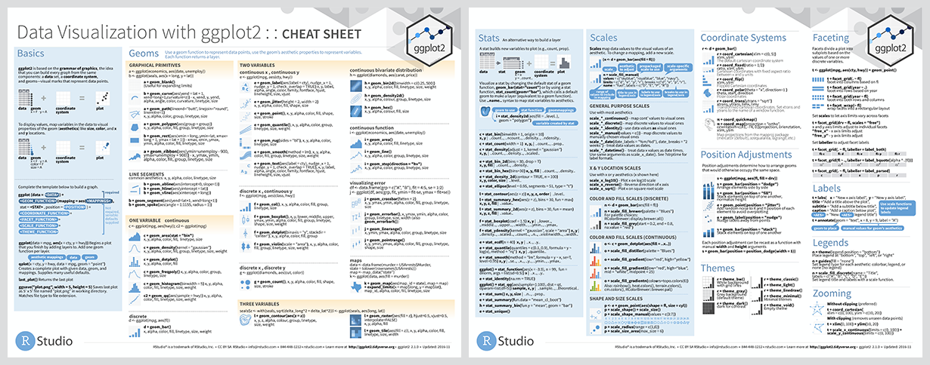
ggplot2 Cheat Sheet

Slide 69
ggplot2 Cheat Sheet

Slide 70
Tidyverse
Packages to help organize data and streamline R coding, specifically for data science
Functions in the packages share similar syntax and coding structure
“dplyr”, “tidyr”, and “ggplot2” are part of tidyverse
https://www.tidyverse.org/

Slide 71
Lubridate
Package for more effectively working with dates between Excel and R
Can recognize date/times with minimal formatting issues
Also allows for date/time differencing, among other useful functions
Included in tidyverse
https://lubridate.tidyverse.org/

Slide 72
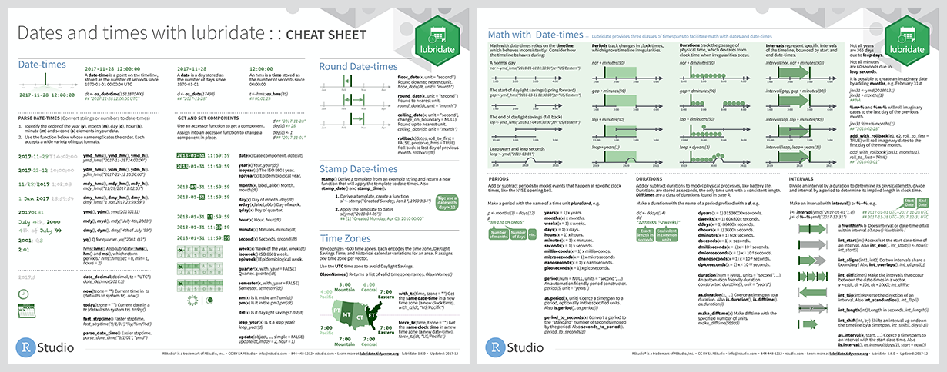
Lubridate

Slide 73
Lubridate

Slide 74
ColorBrewer
Pre-made color schemes and palettes
Effective graphic color selections for maximum perception
Qualitative, sequential, and diverging
Includes options for photo-copy friendly, color-blind friendly, etc.
http://colorbrewer2.org/

Slide 75
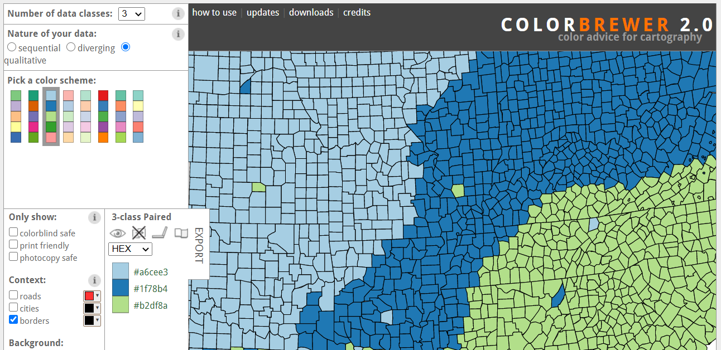
ColorBrewer

Slide 76
Swirl
Package for self-guided learning of R in the R environment
Learn at your own pace and select topics most useful to you
Introductory material
Regressions
Data wrangling
Statistical inference
Advanced programming
https://swirlstats.com/

Slide 77



Thank you for joining!
to share feedback or ask questions, please feel free to contact me:
zeisleaa@miamioh.edu
@AddisonZeisler

